Slide 1
Short-run Macroeconomic Equilibrium
Background to the Theory

Slide 2
The relationship between aggregate demand and national income
This chapter explains what determines the level of national income (GDP) in the short run.
It is based on the model developed by John Maynard Keynes, back in the 1930s.
The basic explanation is quite simple: the level of production in the economy depends on the level of aggregate demand.

Slide 3
The relationship between aggregate demand and national income
If people buy more, firms will produce more in response to this, provided they have spare capacity.
If people buy less, firms will cut down their production and lay off workers.
But just how much will national income rise or fall as aggregate demand changes? We will answer this as the chapter progresses

Slide 4


A simplified circular flow of income model
J = I + G + X
Incomes
C_{d}
W = S + T + M

Slide 5
In equilibrium, withdrawals equal injections
W=J
∴Cd +W =Cd +J
∴Y=E(=AD)
What happens when aggregate expenditure (Cd +J) exceeds national income (Cd + W), and injections exceed withdrawals?
  J>W→Y↑→W↑until W=J: the reverse is true

Slide 6
BACKGROUND TO THE THEORY
But how much will national income rise when aggregate expenditure rises?
What will the new equilibrium level of national income be?
Notes:
2

Slide 7
Defining aggregate demand and national income
Since national income is part of the model, we say that consumption and withdrawals are endogenous variables.
Injections, however, are assumed to be exogenous: they are determined independently of what is going on in the model; they do not depend on the level of national income

Slide 8
Defining aggregate demand and national income
The 45⁰ line serves as reference line that translates any horizontal distance into an equal vertical distance.
Thus anywhere on the 45⁰ line is labeled as:
AD = Y

Slide 9


The 45° line
AD
C_{d,} W, J
C_{d} + W (=Y)
Gh¢100bn
45⁰
O
Gh¢100bn
Y

Slide 10
BACKGROUND TO THE THEORY
Consumption
Consumption is one of the determinants of aggregate demand.
The demand for consumption goods is not constant in practice but increases within income
Thus, families with higher incomes consume more than families with lower incomes and countries where income is higher incomes typically have higher levels of total consumption.
Consumption function: Is a function that shows the relationship between consumption and income
Notes:
2

Slide 11
BACKGROUND TO THE THEORY
Defining aggregate demand and national income
The 45° line diagram
  the significance of the 45° line
Consumption
  the consumption function
  the marginal propensity to consume (mpc)
Notes:
2

Slide 12
National income (Gh¢) | Consumption (Gh¢)
0 | 10
10 | 18
20 | 26
30 | 34
40 | 42
50 | 50
60 | 58
70 | 66
80 | 74

Slide 13



The consumption function
Y
C
88
Consumption
ΔC = 8
ΔY = 10
mpc = ΔC / ΔY
= 8/10
= 0.8
50
90
50
Y

Slide 14
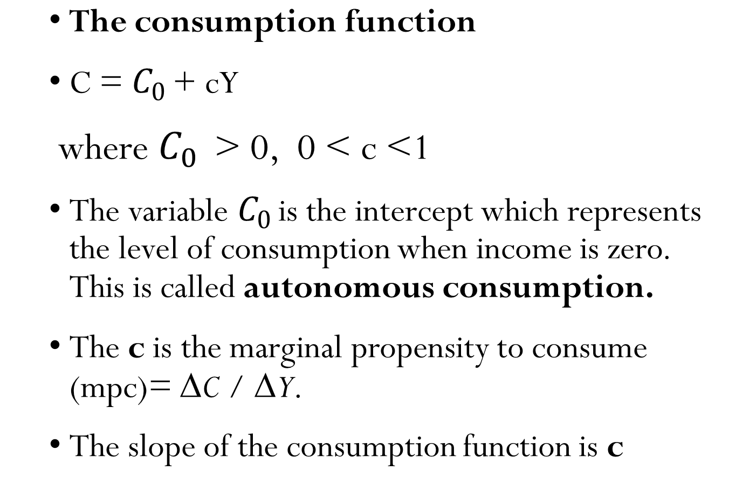
BACKGROUND TO THE THEORY
Notes:
2

Slide 15
BACKGROUND TO THE THEORY
  The consumption function
  The marginal propensity to consume measures the extent of increase in consumption as income increase by one unit.
  For example, a specific consumption function could be specified as:
  C = 100 + 0.6Y
  The autonomous consumption is Gh¢100 and the mpc is 0.6 (=ΔC/ΔY).
  Quiz: If income increases by Gh¢100, by how much will consumption increase?
Notes:
2

Slide 16
BACKGROUND TO THE THEORY
  The consumption and Savings
  There is a unique between consumption and savings. If disposable income (income minus tax) is not consumed, then it must be saved.
  Therefore, income is either consumed or saved
  It follows then that any theory that explains consumption is equally explaining the behaviour of savings
  Savings Function: The savings function relates the level of savings to the level of income.
Notes:
2

Slide 17
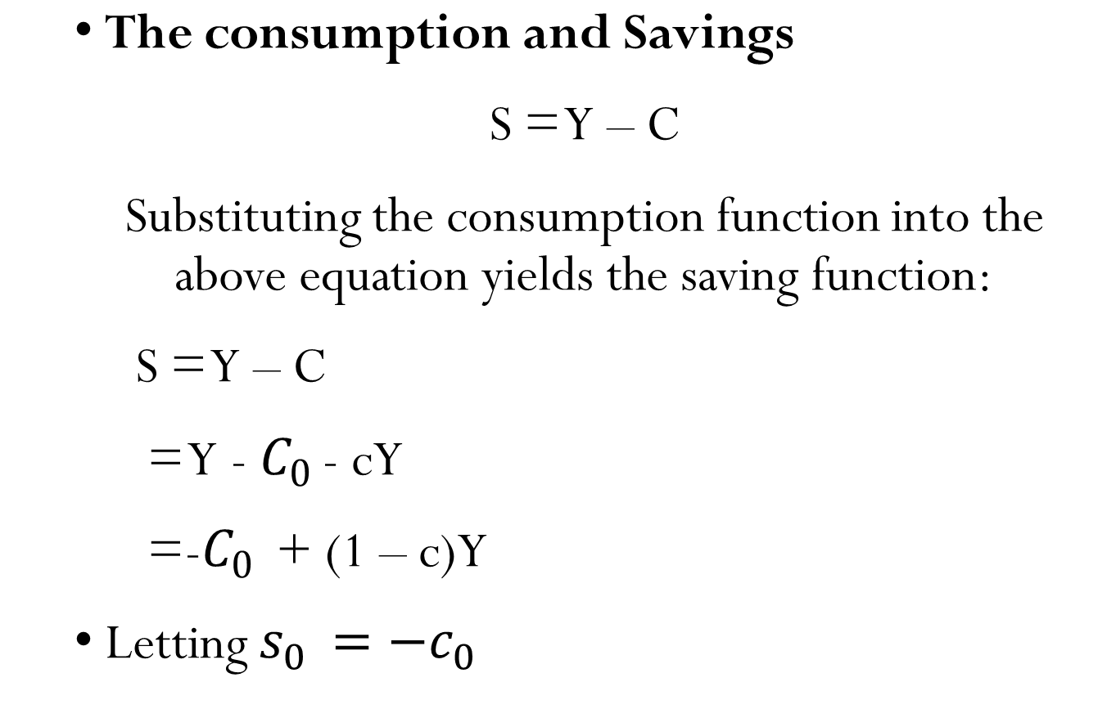
BACKGROUND TO THE THEORY
Notes:
2

Slide 18
BACKGROUND TO THE THEORY
  The consumption and Savings
  The slope of the savings function is (1 – c)=ΔS/ΔY.
  The value is positive. Why?
  Thus if income increases by Gh¢1, savings will increase by (1 – c).
  Quiz: if income increases by Gh¢200, by how much will savings increase?
Notes:
2

Slide 19
BACKGROUND TO THE THEORY
  The consumption and Savings
  The (1 – c) is referred to as marginal propensity to save (mps) which could be denoted by small s
  The marginal propensity to save measures the extent of increase in savings as income increases by one unit.
Notes:
2

Slide 20
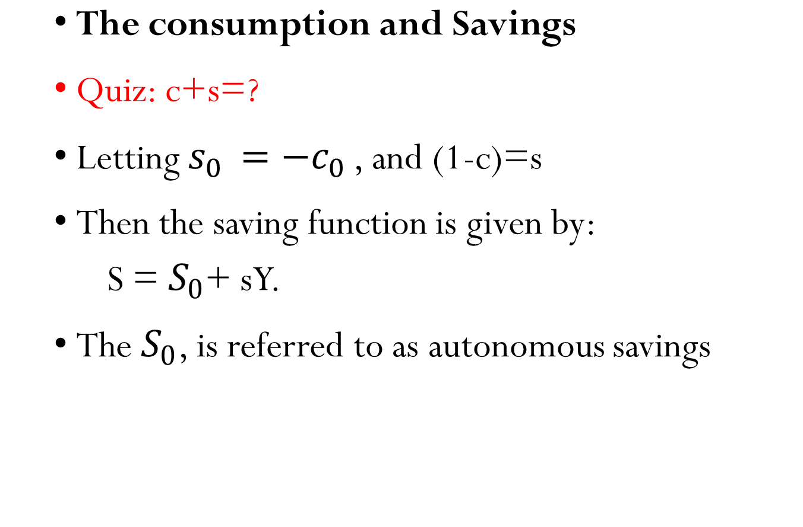
BACKGROUND TO THE THEORY
Notes:
2

Slide 21
Other determinants of consumption
Assets held
Taxation
Expectations of future prices and incomes
The distribution of income
  The poor have a higher mpc than the rich, with very little left over to save. A redistribution of national income from the poor to the rich will therefore tend to reduce the total level of consumption in the economy
Tastes and attitudes
  buy now, pay later’ mentality, or a craving for consumer goods
  consumerist’ and materialistic

Slide 22
Long and short run consumption function
The long-run consumption function is likely to be steeper than the short-run one
In the short run, people may be slow to respond to a rise in income.
Perhaps they are cautious about whether their higher income will last, or are slow to change their consumption habits. In the short run, then, people may have a relatively low mpc.
In the long run, however, people have time to adjust their consumption patterns

Slide 23

Long-run and short-run consumption functions
Y
C_{10 years’ time}
C_{5 years’ time}
Consumption
C_{now}
Consumption is more responsive to a change in income in the long run.
Y

Slide 24

Long-run and short-run consumption functions
Y
C_{long run}
C_{10 years’ time}
C_{5 years’ time}
Consumption
C_{now}
Consumption is more responsive to a change in income in the long run.
Y

Slide 25
BACKGROUND TO THE THEORY
Defining aggregate demand and national income
The 45° line diagram
  the significance of the 45° line
Consumption
  the consumption function
  the mpc
  other determinants of consumption
  short-run and long-run consumption functions
  the consumption of domestically produced goods
Notes:
2

Slide 26

The consumption of domestic product
Y
C
Consumption
C_{d}
C_{d} excludes imports and indirect taxes.
Y

Slide 27
BACKGROUND TO THE THEORY
Withdrawals (W)
  net saving: saving minus consumer borrowing and drawing on past savings
  the saving function
    the mps
  Determinants of saving
    To a large extent these are the same as the other determinants of consumption
Notes:
3

Slide 28
BACKGROUND TO THE THEORY
Withdrawal
Net taxes: Tax functions
As national income increases, so the amount paid in tax will also increase.
The marginal tax propensity or marginal propensity to tax (mpt) is the proportion of an increase in national income paid in taxes.
Notes:
3

Slide 29
BACKGROUND TO THE THEORY
Withdrawal
Net taxes: Tax functions
In a simple world where there was only one type of tax, which was charged at a constant rate – for example, an income tax of 22 per cent – the mpt would be given directly by the tax rate
Notes:
3

Slide 30
BACKGROUND TO THE THEORY
Withdrawal
Tax function
T = tY
mpt = ΔT / ΔY=t
t is the tax rate
However, in most countries, the mpt rises as national income rises.
This is because income tax is progressive. At higher incomes, people pay a higher marginal rate of income tax
Notes:
3

Slide 31
BACKGROUND TO THE THEORY
Withdrawal
Imports
The higher the level of national income, the higher will be the amount spent on imports
The marginal propensity to import (mpm) is the proportion of an increase in national income that is spent on imports
mpm = ΔM/ΔY
Notes:
3

Slide 32
BACKGROUND TO THE THEORY
Withdrawal
Imports
The mpm rises or falls as national income rises depends on the nature of a country’s imports.
If a country imports predominantly basic goods, which have a relatively low income elasticity of demand, the rate of increase in their consumption would tail off rapidly as incomes increase.
The mpm for such a country would thus also rapidly decrease.
Notes:
3

Slide 33
BACKGROUND TO THE THEORY
Withdrawal
Imports
If, however, a country’s imports were mainly of luxury goods, they would account for an increasing proportion of any rise in national income
The mpm would rise.
Notes:
3

Slide 34
BACKGROUND TO THE THEORY
Withdrawal
Imports
If, however, a country’s imports were mainly of luxury goods, they would account for an increasing proportion of any rise in national income
The mpm would rise.
Notes:
3

Slide 35
Determinants of imports
Relative prices (exchange rate)
Tastes.
Relative quality

Slide 36
BACKGROUND TO THE THEORY
The total withdrawals function
Note: withdrawals consist of the three elements: net saving, net taxes and imports, all of which rise as national income rises
The formula for the marginal propensity to withdraw (mpw) is as we would expect:
mpw = ΔW/ΔY
Notes:
3

Slide 37
BACKGROUND TO THE THEORY
The total withdrawals function
The mpw is the slope of the withdrawals function
It is proportion of an increase in national income that is withdrawn from the circular flow
Note that, since W = S + T + M
Therefore, mpw = mps + mpt + mpm
Note also that, since C_{d} + W = Y,
Then, mpc_{d} + mpw =1
Notes:
3

Slide 38
The W and C_{d} functions
C_{d}, W
C_{d} + W (=Y)
100
C_{d}
70
W
30
O
100
Y

Slide 39
BACKGROUND TO THE THEORY
Injections
Note: Injections are autonomous: thus their curves are horizontal straight lines
Investment: Determinants of Investment
    increased consumer demand
    Expectations
    The cost and efﬁciency of capital equipment
    The rate of interest
Notes:
4

Slide 40
BACKGROUND TO THE THEORY
Injections
Note: Injections are autonomous: thus their curves are horizontal straight lines
Investment: Determinants of Investment
    increased consumer demand
    Expectations
    The cost and efﬁciency of capital equipment
    The rate of interest
Notes:
4

Slide 41
BACKGROUND TO THE THEORY
Injections (J)
Government expenditure
  The government budget
  Government budget surplus: T>G
  Government budget deficit: T<G
  where T is tax revenue
Exports
  Via other countries’ circular flows of income
  Via the exchange rate
Total Injections=I+G+X
Notes:
4

Slide 42
The injections and withdrawals functions
C_{d}, W, J
W
J
O
Y

Slide 43
Determination of National Income

Slide 44
Equilibrium National Income
We defined aggregate expenditure (AE) as C+ J
Graphically, then, the AE function is simply the C function shifted upwards by the amount of J.
Equilibrium national income can be found in either of two ways.
Withdrawals equal Injection
Income equals Aggregate expenditure

Slide 45
DETERMINATION OF NATIONAL INCOME
Equilibrium national income
  Withdrawals equal injections
  W=J
  S+T+M=I+G+X
Notes:
5

Slide 46

Deriving equilibrium national income
C_{d}, W, J
W
O
Y

Slide 47
Deriving equilibrium national income
C_{d}, W, J
If injections exceed withdrawals, national income will rise.
W
a
J
b
O
Y₁
Y

Slide 48
Deriving equilibrium national income
C_{d}, W, J
If withdrawals exceed injections, national income will fall.
W
c
d
J
O
Y₂
Y

Slide 49
Deriving equilibrium national income
C_{d}, W, J
Equilibrium national income is where W = J.
W
x
J
O
Y_{e}
Y

Slide 50
DETERMINATION OF NATIONAL INCOME
Equilibrium national income
  withdrawals equal injections
  Income equals Aggregate Expenditure
Notes:
5

Slide 51
Deriving equilibrium national income
C_{d}, W, J
Y = C_{d} + W
W
J
O
Y

Slide 52
Deriving equilibrium national income
C_{d}, W, J
Y = C_{d} + W
AE = C_{d} + J
C_{d}
J
W
J
O
Y

Slide 53
Deriving equilibrium national income
C_{d}, W, J
If aggregate expenditure exceeds national income, national income will rise.
Y = C_{d} + W
AE = C_{d} + J
C_{d}
e
W
f
J
O
Y₁
Y

Slide 54
Deriving equilibrium national income
C_{d}, W, J
If national income exceeds aggregate expenditure, national income will fall.
Y = C_{d} + W
g
E = C_{d} + J
h
C_{d}
W
J
O
Y₂
Y

Slide 55
Deriving equilibrium national income
C_{d}, W, J
Equilibrium national income is where Y = E (and W = J).
Y = C_{d} + W
E = C_{d} + J
C_{d}
z
W
x
J
O
Y_{e}
Y

Slide 56
DETERMINATION OF NATIONAL INCOME
Equilibrium national income
  withdrawals equal injections
  income equals expenditure
The multiplier: Introduction
Notes:
5

Slide 57
DETERMINATION OF NATIONAL INCOME
The multiplier
When injections rise (and continue at the higher level), this will cause national income to rise.
But by how much? In fact, national income will rise by more than injections: Y rises by a multiple of the rise in J.
ΔY>ΔJ
Notes:
5

Slide 58
The number of times that the increase in income (ΔY) is greater than the increase in injections (ΔJ) is known as the multiplier (k).
Definition of the multiplier: ΔY/ΔJ
k= ΔY/ΔJ
Example: If Gh¢10 billion rise in injections caused a Gh¢30 billion rise in national income, the multiplier would be 3 (=30b/10b)

Slide 59
DETERMINATION OF NATIONAL INCOME
What determines the size of the multiplier?
The withdrawals and injections approach
  Graphical analysis: shift in the J line
Notes:
6

Slide 60
The multiplier: (a) a shift in injections
W, J
W
a
J₁
O
Y_{e1}
Y

Slide 61
The multiplier: (a) a shift in injections
W, J
W
b
J₂
a
J₁
O
Y_{e1}
Y_{e2}
Y

Slide 62
The multiplier: (a) a shift in injections
W, J
Multiplier = ΔY / Δ J
= ΔY / ΔW
= c−a / b−c
W
b
J₂
J₂
Δ J
a
Δ W
J₁
J₁
c
O
Y_{e1}
Y_{e2}
Y
ΔY

Slide 63
The multiplier: (a) a shift in injections
W, J
Multiplier = ΔY / Δ J
= ΔY / ΔW
= c−a / b−c
but mpw= b−c/ c−a
Therefore, multiplier= 1/mpw
W
b
J₂
J₂
Δ J
a
Δ W
J₁
J₁
c
O
Y_{e1}
Y_{e2}
Y
ΔY
Notes:
If less is withdrwawn(More income available to spend), the total demand increases and hence increases the overall income(that’s why smaller mpc means bigger multiplier)

Slide 64
DETERMINATION OF NATIONAL INCOME
The multiplier: the withdrawals and injections approach
  The size of the multiplier varies inversely with the size of the mpw
  the formula: k=(1/mpw)
  But mpc + mpw =1
  Therefore, k=1/(1 – mpc)
  Thus, the smaller the mpw the bigger the multiplier, and vice versa. Also, the bigger the mpc, the bigger the multiplier and vice versa.
Notes:
6

Slide 65
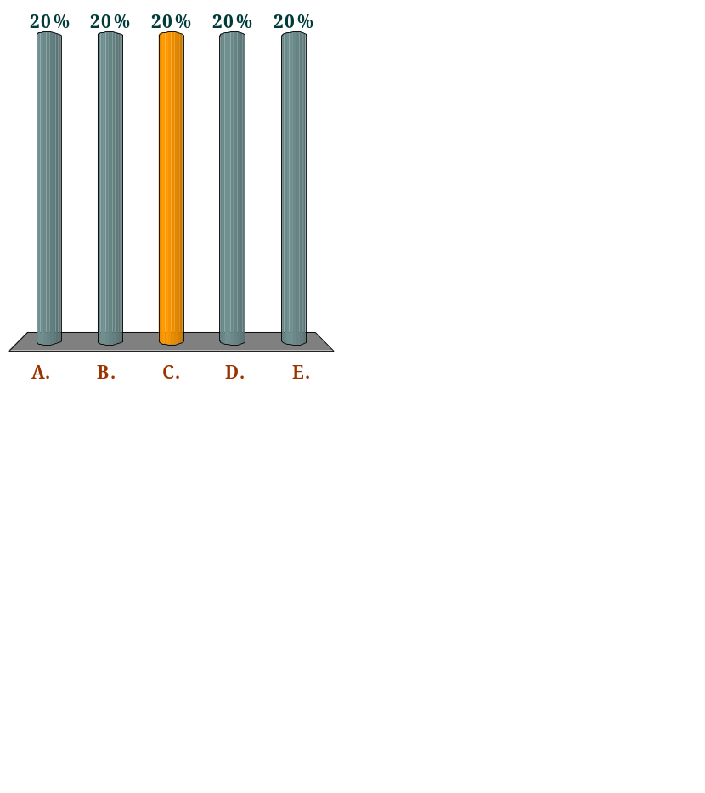
If a rise in national income of £100m causes consumption of domestic goods and services to rise by £60m, the multiplier is:
Q
6
4
2.5
2
1.67
Notes:
mpc=ΔC/ΔY=60/100=3/5
Multiplier, k=1/(1-mpc) =1/(1-3/5)=2.5

Slide 66
What causes the multiplier effect? The answer is that, when extra spending is injected into the economy, it will then stimulate further spending, which in turn will stimulate yet more spending and so on.
For example, if firms decide to invest more, this will lead to more people being employed and hence more incomes being paid to households.
Households will then spend part of this increased income on domestically produced goods (the remainder will be withdrawn).

Slide 67
This increased consumption will encourage firms to produce more goods to meet the demand.
Firms will thus employ more people and other factors of production.
This leads to even more incomes being paid out to households. Consumption will thus increase yet again. And so the process continues.

Slide 68
The multiplier is an example of an important principle in economics: that of cumulative causation
Principle of cumulative causation: An initial event can cause an ultimate effect that is much larger.

Slide 69
DETERMINATION OF NATIONAL INCOME
  Numerical illustration
  The multiplier effect does not work instantaneously.
  When there is an increase in injections, whether investment, government expenditure or exports, it takes time before this brings about the full multiplied rise in national income.
Notes:
6

Slide 70
DETERMINATION OF NATIONAL INCOME
  Numerical illustration
  Example:
  Let us assume for simplicity that the mpw is 0.5.
  This will give an mpc of 0.5
  Let us also assume that investment (an injection) rises by £160 million and stays at the new higher level
Notes:
6

Slide 71
The multiplier ‘round’
Assumptions
mpw = 0.5
Increase in injections of £160m

Slide 72

The multiplier ‘round’
Assumptions
mpw = 0.5
Increase in injections of £160m

Slide 73

The multiplier ‘round’
Assumptions
mpw = 0.5
Increase in injections of £160m

Slide 74
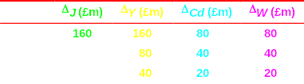
The multiplier ‘round’
Assumptions
mpw = 0.5
Increase in injections of £160m

Slide 75
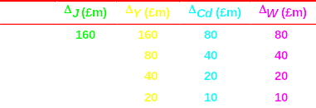
The multiplier ‘round’
Assumptions
mpw = 0.5
Increase in injections of £160m

Slide 76
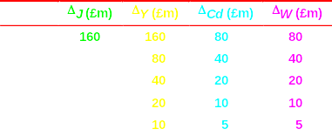
The multiplier ‘round’
Assumptions
mpw = 0.5
Increase in injections of £160m

Slide 77
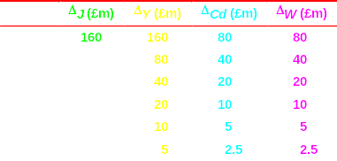
The multiplier ‘round’
Assumptions
mpw = 0.5
Increase in injections of £160m

Slide 78
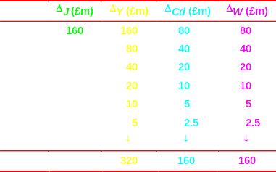
The multiplier ‘round’
Assumptions
mpw = 0.5
Increase in injections of £160m

Slide 79
DETERMINATION OF NATIONAL INCOME
  The withdrawals multiplier
Notes:
6

Slide 80
The multiplier: (b) a shift in withdrawals
W, J
W₁
a
J
O
Y_{e1}
Y

Slide 81
The multiplier: (b) a shift in withdrawals
W, J
W₁
W₂
a
c
J
O
Y_{e1}
Y
Y_{e2}

Slide 82

The multiplier: (b) a shift in withdrawals
W, J
Multiplier = ΔY / ΔW
= c−a / a−b
W₁
W₂
a
c
J
ΔW
b
O
Y_{e1}
Y
ΔY
Y_{e2}

Slide 83
DETERMINATION OF NATIONAL INCOME
The multiplier: the income and expenditure approach
Notes:
6

Slide 84
DETERMINATION OF NATIONAL INCOME
The multiplier: the income and expenditure approach
Injection multiplier
  graphical analysis
Notes:
6

Slide 85
The multiplier: (c) a shift in the expenditure curve
E, W, J
Y
E₁
O
Y_{e1}
Y

Slide 86
The multiplier: (c) a shift in the expenditure curve
E, W, J
Y
E₂
E₁
O
Y_{e1}
Y_{e2}
Y

Slide 87
The multiplier: (c) a shift in the expenditure curve
E, W, J
Y
Multiplier = ΔY / Δ J
= c−a / b−a
E₂
E₁
c
ΔY
b
Δ J
a
O
Y_{e1}
Y_{e2}
Y

Slide 88
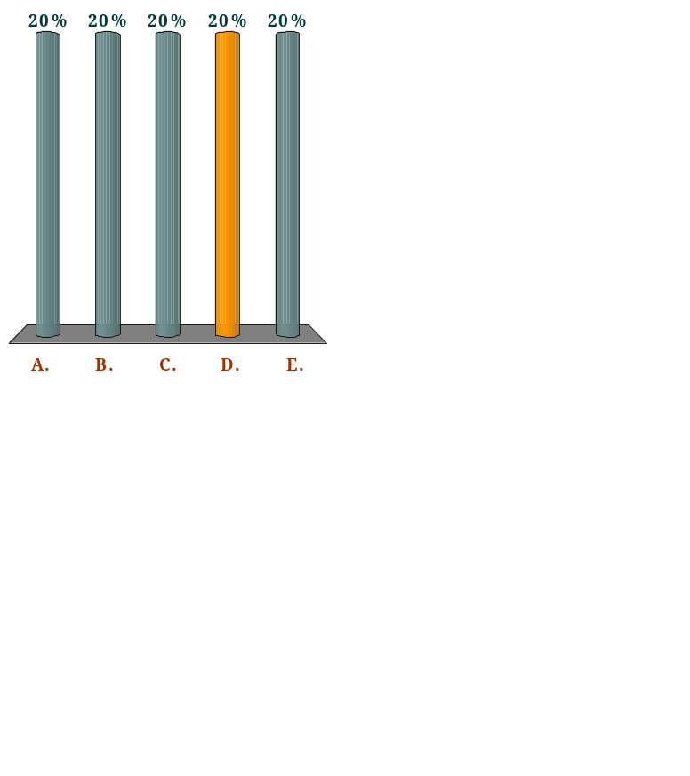
Which of the following would cause the value of the multiplier to fall?
Q
A cut in the level of government spending
An increase in the marginal propensity to consume
A fall in the level of investment
The population becomes more thrifty, and saves a larger proportion of any rise in income.
Exports rise faster than imports.
Notes:
If people save more(consumes less), the mpc becomes small thereby making the multiplier small too

Slide 89

The value of the multiplier will definitely rise (ceteris paribus) if:
Q
the mpc_{d} and the mpm both rise.
the mpc_{d} falls and the marginal rate of income tax falls.
the mpc_{d} rises and the mpm falls.
exports rise faster than imports.
the mps falls and the mpc_{d} also falls.
Notes:
If mpc(d) rises, more domestic consumption increases income. Also, mpm falls means less spending on outside goods(higher domestic spending) which means income will increase. More income means higher multiplier

Slide 90
DETERMINATION OF NATIONAL INCOME
  Numerical illustration
Notes:
6

Slide 91
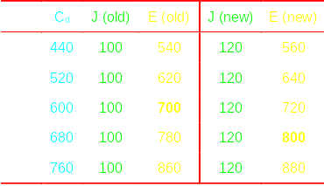
The effect of an increase
in aggregate expenditure

Slide 92
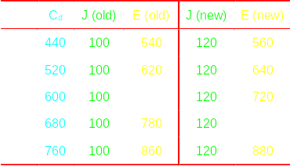
The effect of an increase
in aggregate expenditure

Slide 93
DETERMINATION OF NATIONAL INCOME
  Numerical illustration
  Assume :
  C=200+0.8Y^{d}
  I=100
  Y^{d}=Y-T is Disposable income
  T=0.2Y
  Find the equilibrium national Income:
Notes:
6

Slide 94
DETERMINATION OF NATIONAL INCOME
  1. Income equals Aggregate expenditure
  At equilibrium: AD=Y
  AD=C+I+X-M; but in this question we only have C and I
  AD=C+I
  Y=200+0.8(Y-T)+I
  Y=200+0.8Y-0.8T+I
  Y=200+0.8Y-0.8(0.2Y)+I
  Y=200+0.64Y+I
  Y-0.64Y=200+I
  Y=(200+I)/0.36
Notes:
6

Slide 95
DETERMINATION OF NATIONAL INCOME
  1. Income equals Aggregate expenditure
  Note: investment multiplier=ΔY/ΔI=(1/0.36)=2.27
  Equilibrium National Income:
  Y_{e}=(200+100)/0.36
  Y_{e}=(300)/0.36
  Y_{e}=833.33
Notes:
6

Slide 96
DETERMINATION OF NATIONAL INCOME
  Numerical illustration:
  2. Withdrawals equal injections approach
Notes:
6

Slide 97
DETERMINATION OF NATIONAL INCOME
  2. Withdrawals equal injections approach
  S+T+M=I+G+X
  S+T=I
  We only have T and I: but can derive S from C using T
  C=200+0.8(Y-T)
  C=200+0.8Y-0.8T
  C=200+0.8Y-0.8(0.2Y)
  C=200+0.64Y
  S=Y-C
Notes:
6

Slide 98
DETERMINATION OF NATIONAL INCOME
  2. Withdrawals equal injections approach
  C=200+0.8(Y-T)
  C=200+0.8Y-0.8T
  C=200+0.8Y-0.8(0.2Y)
  C=200+0.64Y
  Note that: S=Y-C
  S=Y- 200-0.64Y
  S=-200+0.36Y
  Recall: S+T=I
  Note: S=I, since T has already being taken care off
Notes:
6

Slide 99
DETERMINATION OF NATIONAL INCOME
  2. Withdrawals equal injections approach
  S=-200+0.36Y
  Note: S=I, since T has already being taken care off
  -200+0.36Y=100
  0.36Y=300
  Y_{e}=(300)/0.36
  Y_{e}=833.33
Notes:
6

Slide 100
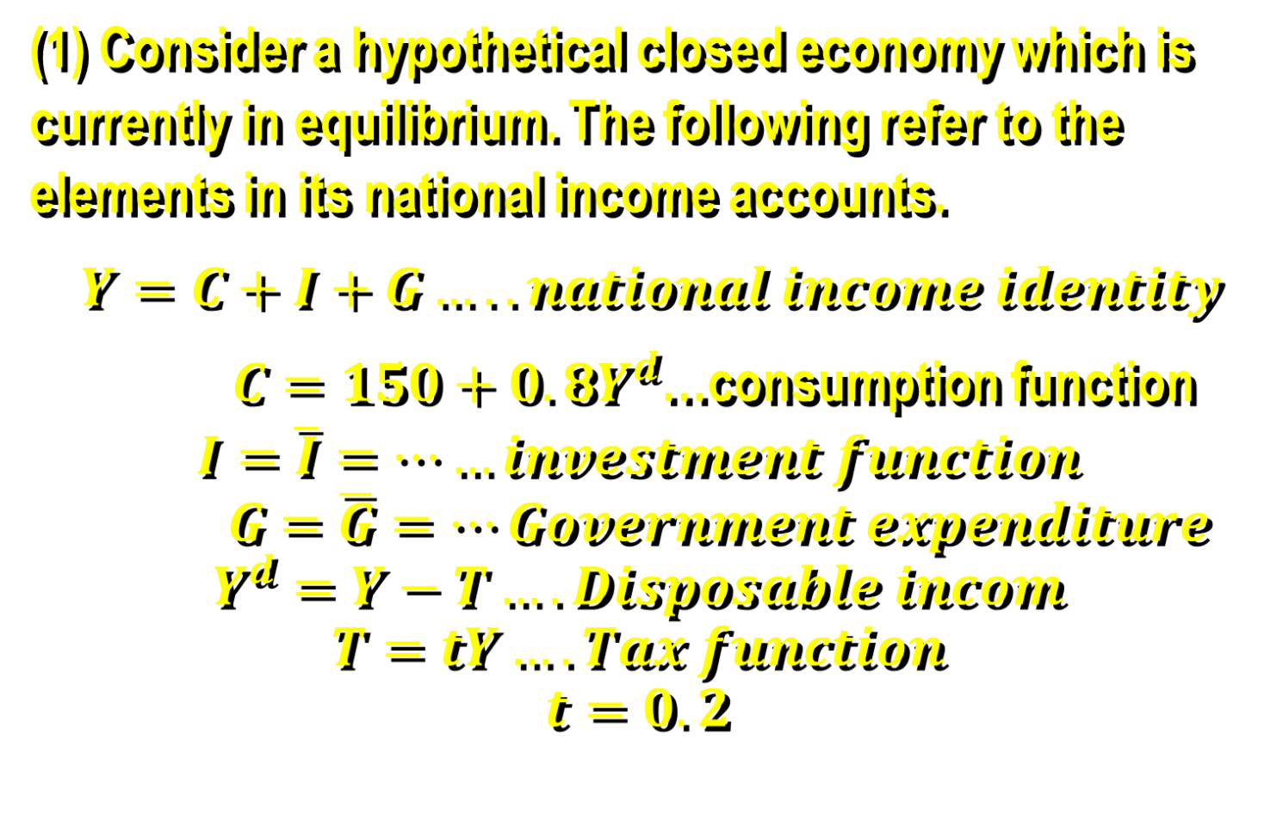
Assignment

Slide 101
Answer the following:
  Calculate the equilibrium national income.
  What is the equilibrium value of consumption expenditure?
  What is the autonomous consumption and disposable income? Interpret them.
  What is the tax rate in this economy and hence calculate the total tax revenue? Explain effect of a higher tax rate on disposable income and withdrawals.

Slide 102
  (vi) Assuming, investment expenditure increases by 20 billion cedis, by how much will national income increase?
  (v) Calculate the investment multiplier and explain what it means.

